Slide 1


Forecasting Of Temperature using ARIMA Model
SRM INSTITUTE OF SCIENCE AND TECHNOLOGY
COLLEGE OF ENGINEERING AND TECHNOLOGY
DEPARTMENT OF COMPUTATIONAL INTELLIGENCE
18CSP108L- MINOR PROJECT
Student 1: Anurag Malik
Reg No: RA2011026010030
Student 2: Anmol Agrawal
Reg No: RA2011026010034

Slide 2
Abstract
The project aims to enhance climate change awareness and mitigation by precisely forecasting temperature changes using data-driven ARIMA models recognizing the urgency of climate change..
ARIMA (Auto Regressive Integrated Moving Averages) models are selected for their accuracy in time series analysis, providing a robust foundation for temperature prediction.
A grid-search approach automates the selection of crucial model parameters (p and q) to optimize accuracy, with a focus on minimizing the Akaike Information Criterion (AIC) values.
Combining computer science knowledge with environmental awareness, the project strives to bridge the gap between data science and climate concerns.
By improving temperature forecasts and highlighting imminent shifts, the project aims to raise awareness, encourage sustainable practices, and inspire further research at the intersection of data science and environmental issues.

Slide 3

Introduction
The project operates within the context of intensifying global climate change, emphasizing the critical need for accurate temperature predictions.
It combines Computer Science and forecasting techniques to address climate awareness and empower informed decisions.
The project utilizes automated parameter selection within ARIMA models, optimizing accuracy through grid-search methods and minimizing Akaike Information Criterion (AIC) values.
It embodies a harmonious blend of scientific innovation and environmental consciousness, demonstrating a commitment to climate solutions.
The project aims to raise awareness, foster sustainable practices, and encourage further research at the intersection of data science and environmental concerns to tackle climate change effectively.

Slide 4
Motivation
Create a forecasting model utilizing historical data to create an ARIMA-based model for exact short-term temperature forecasts, which will assist in predicting future climate patterns.
1
Raise Climate Awareness: Turn predicted temperature changes into actual facts to raise awareness and urgency about the implications of global warming.
2
Analyze historical temperature patterns to find hidden tendencies that provide vital insights into the course of climate change.
3
Improve Model Accuracy: Automate parameter selection inside the ARIMA model to provide accurate predictions, which can be checked by comparing forecasts to actual temperature data.
4
Enable Informed Decisions: Provide individuals and communities with accurate temperature projections, allowing for proactive planning and adaption methods to reduce climate-related hazards.
5

Slide 5
Innovation
1.Data Collection and Preprocessing: Gather historical temperature data from reliable sources, ensuring data quality and consistency. Clean, transform, and preprocess the data to handle missing values, outliers, and inconsistencies, preparing it for analysis.
2. Exploratory Data Analysis (EDA): Conduct a comprehensive exploration of the historical temperature data. Identify patterns, trends, and seasonal variations to gain insights into temperature fluctuations over time. EDA serves as a foundation for selecting appropriate forecasting models.
3. ARIMA Model Selection: Choose the ARIMA (AutoRegressive Integrated Moving Averages) forecasting model as the primary method due to its effectiveness in handling time series data. Determine the order of differencing (integration) required to make the data stationary and select appropriate autoregressive (AR) and moving average (MA) terms.
4. Automated Parameter Selection: Implement a grid-search technique to automate the process of identifying optimal values for the p (autoregressive) and q (moving average) parameters. This ensures the model's accuracy by selecting parameters that minimize the Akaike Information Criterion (AIC).

Slide 6
6. Temperature Forecasting: Utilize the trained ARIMA model to generate short-term temperature forecasts. These forecasts provide valuable insights into future temperature trends and help anticipate potential temperature fluctuations.
7. Performance Evaluation: Quantitatively evaluate the accuracy of the ARIMA model's forecasts using evaluation metrics. Compare the model's predictions with actual temperature observations to assess its reliability and potential areas for improvement.
8. Visualization and Interpretation: Create visualizations, such as time series plots and forecast plots, to present the model's predictions alongside historical temperature data. These visualizations aid in understanding temperature trends and validating the model's performance
5. Model Training and Validation: Divide the data into training and validation sets. Train the ARIMA model on the training data and validate its performance on the validation set. Use metrics like Mean Absolute Error (MAE), Root Mean Square Error (RMSE), and AIC to assess the model's accuracy.

Slide 7
Requirement Gathering
Data Sources:
Historical Temperature Data: Identify and access reliable sources of historical temperature data. You can explore government agencies, meteorological organizations, and research institutions that provide climate data.
Climate Models and Projections: Depending on your project's scope, you might also need access to climate models and future climate projections. These can be obtained from reputable sources such as the Intergovernmental Panel on Climate Change (IPCC) reports.
Software and Tools:
Data Analysis Tools: Acquire data analysis software and tools such as Python with libraries like pandas, NumPy, and matplotlib for data manipulation and visualization.
ARIMA Modelling Tools: Familiarize yourself with time series analysis libraries and packages in Python, such as stats models, which can be used for ARIMA modelling.
Literature and Research Materials:
Gather relevant research papers, articles, and books on ARIMA modelling, time series analysis, climate science, and climate change impacts. These materials will help you build a strong theoretical foundation for your project.
Data Pre-processing Tools:
For data cleaning and pre-processing, you might need tools like Excel or specialized data cleaning software.
Collaborative Tools:
Communication and collaboration tools such as project management software, video conferencing platforms, and version control systems (e.g., Git) for team collaboration.

Slide 8
Literature Survey
Paper Title | Authors | Abstract | Drawbacks
Forecasting Daily Meteorological Time Series Using ARIMA and Regression Models | Yusof and Kane (2012) | This paper studies the use of ARIMA and regression models for forecasting daily meteorological time series, such as rainfall and temperature. The authors found that ARIMA models can be effective for forecasting these time series, but that the choice of model and parameters is important. | The authors only used data from one location, so the results may not be generalizable to other locations. The authors did not consider the effects of climate change on temperature trends.
Predicting Temperature Data Using ARIMA Model | William Blanzeisky (2022) | This paper describes how to use ARIMA models to predict temperature data. The author provides an overview of ARIMA models and their components, and then walks through an example of how to build and use an ARIMA model to predict temperature data. | The author only used a simple ARIMA model, so the results may not be as accurate as more complex models. The author did not consider the effects of seasonality on temperature data.
Global Temperature Forecast Based on ARIMA Model | Guan Naiqian Guan Yuxin Sun Xuelian | This paper uses ARIMA models to forecast global temperature trends. The authors found that ARIMA models can be effective for forecasting global temperature trends, but that the choice of model and parameters is important. | The authors only used data from the past few decades, so the results may not be generalizable to future climate conditions. The authors did not consider the effects of other factors, such as greenhouse gas emissions, on temperature trends.
Monthly Temperature Prediction Based on ARIMA Model: A Case Study in Dibrugarh Station of Assam, India | K. Goswami | This paper uses a seasonal ARIMA model to predict monthly temperature in Dibrugarh, Assam, India. The authors found that the model was able to accurately predict temperature trends over a period of 50 years. | The authors only used data from one location, so the results may not be generalizable to other locations. The authors did not consider the effects of climate change on temperature trends.

Slide 9
Literature Survey
Paper Title | Authors | Abstract | Drawbacks
Temperature forecasting using ARIMA modeling in R | Ankur Sharma (2019) | This paper describes how to use ARIMA models to forecast temperature data in R. The author provides an overview of ARIMA models and their components, and then walks through an example of how to build and use an ARIMA model to forecast temperature data. | The author only used a simple ARIMA model, so the results may not be as accurate as more complex models. The author did not consider the effects of seasonality on temperature data.
Forecasting temperature using ARIMA and SARIMA models: A comparative study | M. Sivakumar and S. S. Ayyappan (2019) | This paper compares the performance of ARIMA and SARIMA models for forecasting temperature data. The authors found that SARIMA models outperformed ARIMA models in terms of accuracy. | The authors only used data from one location, so the results may not be generalizable to other locations.The authors did not consider the effects of climate change on temperature trends.
Application of ARIMA Model for Temperature Forecasting | S. A. Kumar and M. S. S. Kumar (2018) | This paper describes how to use ARIMA models to forecast temperature data in Python. The authors provide an overview of ARIMA models and their components, and then walk through an example of how to build and use an ARIMA model to forecast temperature data. | The authors only used a simple ARIMA model, so the results may not be as accurate as more complex models.The authors did not consider the effects of seasonality on temperature data.
Forecasting Temperature Time Series Based on ARIMA and Hybrid Models | X. Zhang, S. Yu, and S. Wang (2017) | This paper compares the performance of ARIMA and hybrid models for forecasting temperature data. The authors found that hybrid models outperformed ARIMA models in terms of accuracy. | The authors only used data from one location, so the results may not be generalizable to other locations.The authors did not consider the effects of climate change on temperature trends.
9

Slide 10
Literature Survey
Paper Title | Authors | Abstract | Drawbacks
Temperature forecasting using ARIMA model: A case study of Dhaka, Bangladesh | M. S. Islam and M. A. H. Khan (2015) | This paper uses an ARIMA model to forecast temperature in Dhaka, Bangladesh. The authors found that the model was able to accurately predict temperature trends over a period of 10 years. | The authors only used data from one location, so the results may not be generalizable to other locations.The authors did not consider the effects of climate change on temperature trends.
Forecasting temperature and precipitation using ARIMA model in Python | V. V. R. Sai and D. Ramakrishna (2014) | This paper describes how to use ARIMA models to forecast temperature and precipitation data in Python. The authors provide an overview of ARIMA models and their components, and then walk through an example of how to build and use an ARIMA model to forecast temperature and precipitation data. | The authors only used a simple ARIMA model, so the results may not be as accurate as more complex models.The authors did not consider the effects of seasonality on temperature and precipitation data.
10

Slide 11

RESEARCH GAP / LIMITATIONS
The accuracy of temperature forecasts heavily relies on
the quality and availability of historical temperature data.
Limitations in data coverage, missing data, or inaccuracies
can impact the performance of the ARIMA model and
result in less reliable predictions.
The city-wise monthly temperature data had several
missing values for certain cities. Instead of replacing these
NaN values with the mean temperature, we choose to
remove rows having missing values.
Climate systems are intricate and involve multiple
variables.While ARIMA models are effective for time
series analysis, they may not fully capture the complex
interdependencies within climate data. Consideration of
more sophisticated models may be required for a
comprehensive understanding of temperature changes.
Also, we were not able to fully analyze the effect of
Greenhouse gases on temperature change, due to the
lack of data for gases like ozone (O3) and water vapor.

Slide 12
OBJECTIVE
Regional Climate Impact and Adaptation: The project focuses on specific regional contexts, such as India and the United States, to enhance our understanding of how global climate changes affect local environments. By adapting global research to local contexts, the project aims to provide valuable insights into the unique challenges and impacts of climate change in these regions.
Scientific Legitimacy and Policy Guidance: The project emphasizes the importance of scientific legitimacy in guiding policy decisions. By developing accurate temperature prediction models using ARIMA and demonstrating empirical modeling strategies, the project aims to provide policymakers with reliable data and insights to inform climate-related decision-making and policy formulation in the face of a changing global climate.

Slide 13

PROBLEM STATEMENT
The project seeks to address the pressing issue of climate change by leveraging data-driven ARIMA models to precisely forecast temperature changes. Recognizing the critical urgency of climate change, we aim to provide accurate and timely predictions that can contribute to climate change awareness and mitigation efforts. . Its ultimate goal is to raise awareness, encourage sustainable practices, and motivate further research in the intersection of data science and environmental concerns, thereby enabling more effective action against climate change.

Slide 14
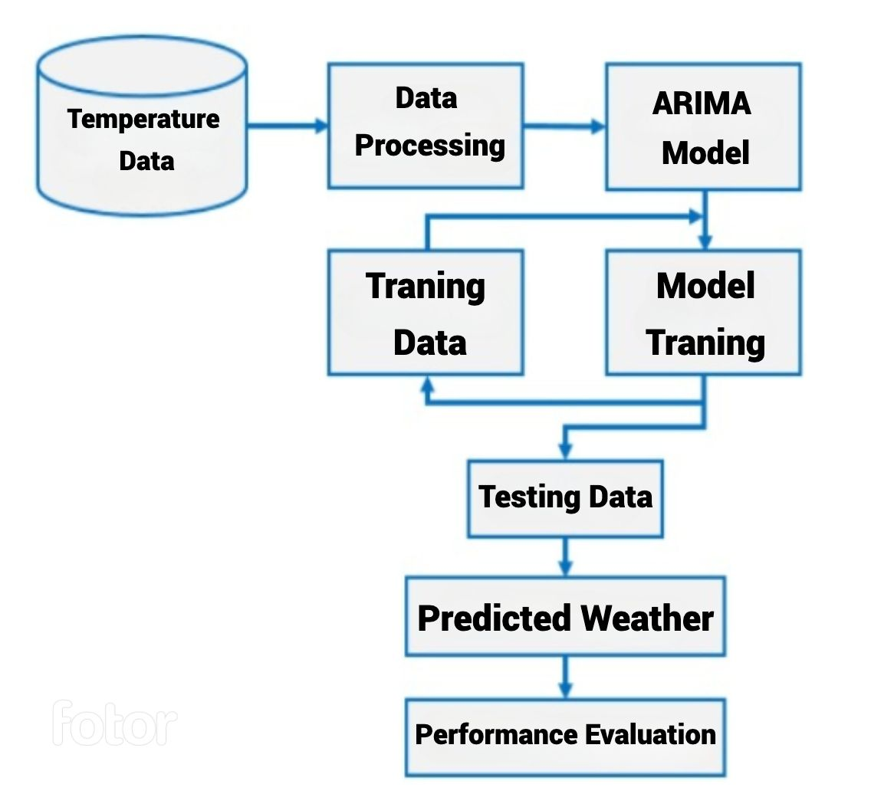
PROPOSED SYSTEM ARCHITECTURE

Slide 15
MODULES DESCRIPTION
1. NumPy: NumPy is a fundamental Python library for numerical computing. It provides support for arrays and matrices, along with mathematical functions to operate on them efficiently. In this code, NumPy is used for data manipulation, handling arrays, and reshaping data for input into the ARIMA model.
2. Pandas: Pandas is a powerful data manipulation and analysis library for Python. It offers data structures like DataFrames that make it easy to organize and work with structured data. In this code, Pandas is used to load, manipulate the data obtained.
3. Scikit-learn (sklearn): Scikit-learn is a machine learning library that provides tools for data preprocessing, model training, and evaluation. In this code, the `ARIMA` from Scikit-learn is used to scale the prediction, which is a common preprocessing step in machine learning.
4. Matplotlib: Matplotlib is a popular Python library for creating static, animated, and interactive visualizations in Python. While not explicitly shown in the code, it's commonly used for visualizing stock price data, model training progress, and prediction results.
5. pandas_datareader: pandas_datareader is an extension to Pandas that allows fetching data from various online sources. Although not explicitly imported in the code, it is often used for downloading data.

Slide 16
Algorithm
p_range = q_range = [i for i in range(0, 3)] # taking values from 0 to 2 best_pq = (0, 0) best_aic = float('inf') # Initialize with a large value
for p in p_range: for q in q_range:
try: model = ARIMA(new_city_df, order=(p, d, q)) #results = model.fit() aic = results.aic bic = results.bic aic_values.append(aic) bic_values.append(bic) pq_values.append((p, q))
# Update best (p, q) if the current model has a lower AIC if aic < best_aic:
best_aic = aic best_pq = (p, q)
except Exception as e: print(f"Error for (p, q) = ({p}, {q}): {str(e)}")
# ARIMA model for the city with the best (p, q)
arima_model = ARIMA(new_city_df, order=(best_pq[0], d, best_pq[1])).fit()

Slide 17

MODEL FOR FORECASTING
Since we have time series data, we have chosen to use an ARIMA (AutoRegressive Integrated Moving Averages) model for time series forecasting.
We have automated the process of estimating the best p, q parameters for the ARIMA model using a grid-search technique, for any given time series data. The p,q values were chosen based on the pair that returned the lowest AIC (Akaike Information Criterion) values.
The model was used to successfully forecast the temperatures for a given city across a specified time period.

Slide 18
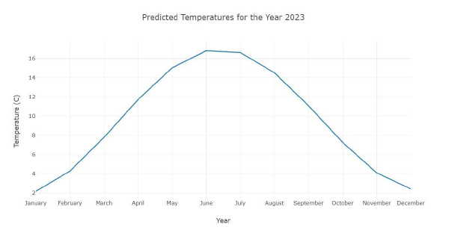
EVALUATION

Slide 19
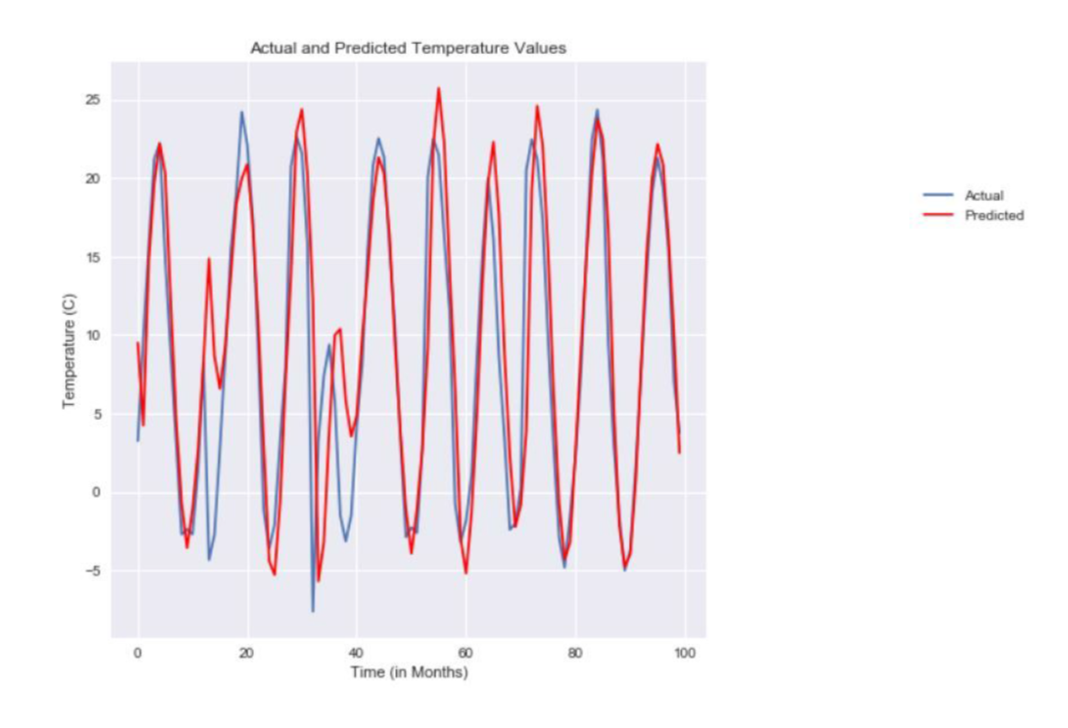
We have used Mean Squared Error (MSE) and Mean Absolute Error (MAE) to evaluate the performance of the ARIMA model.

Slide 20

IMPLEMENTATION / CONCEPTS INVOLVED
The crux of our problem lies in Time Series Forecasting . We have made use of ACF and PACF plots, in combination with AIC values, to estimate the best p, q values for the ARIMA model and have forecasted the temperatures for cities over a given period of time.
We have used libraries including pandas, numpy, matplotlib, sklearn, seaborn, plotly and
statsmodels.
Additionally, we have also used Pearson’s Correlation Coefficient to analyze the pairwise correlations between Pollution, Greenhouse Gas emissions and temperature change.

Slide 21
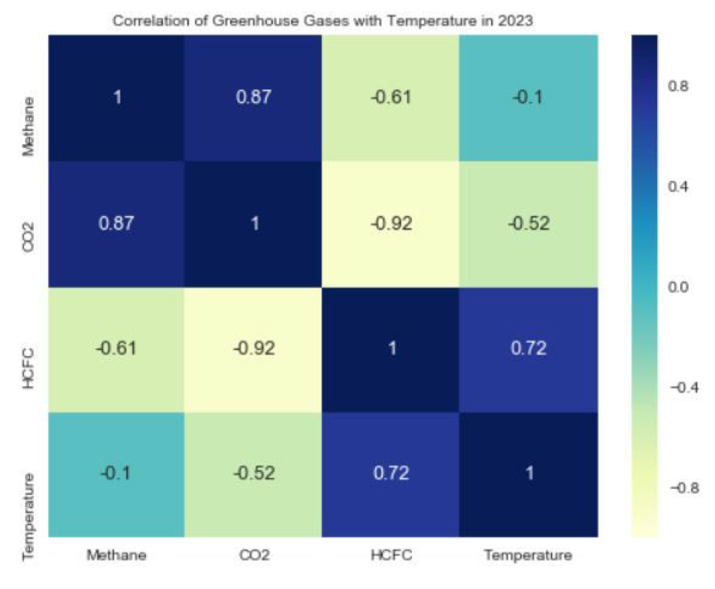
Pearson’s Correlation Coefficient

Slide 22

RESULTS AND DISCUSSIONS
We predicted the temperature of any given city across a specific time period. We also identified the top-10 cities in the India that are likely to experience the most temperature change. Additionally, we analyzed the correlation between pollution levels and temperature, as well as the correlation between Greenhouse gas emissions and temperature, which helped us identify the Greenhouse Gas that has and will have the most impact on temperature change.

Slide 23
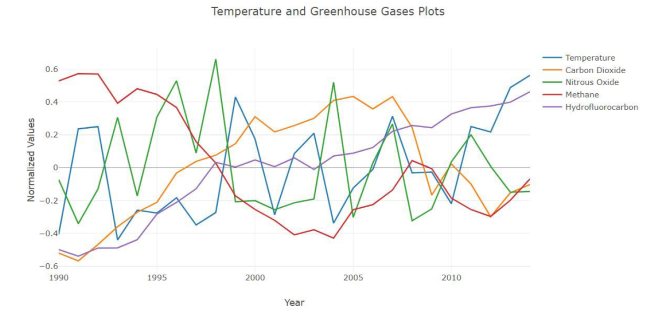
RESULT

Slide 24
Refrences
H. B. Jang, J. Choi, I. Yoon, S.-S. Lim, S. Shin, N. Chang, and S. W. Chung, "Exploiting application/system-dependent ambient temperature for accurate microarchitectural simulation," IEEE Transactions on Computers, vol. 62, no. 4, pp. 705-715, 2013.
F. Pedregosa, G. Varoquaux, A. Gramfort, V. Michel, B. Thirion, O. Grisel, M. Blondel, P. Prettenhofer, R. Weiss, V. Dubourg, J. Vanderplas, A. Passos, D. Cournapeau, M. Brucher, M. Perrot, and E. Duchesnav, "Scikit-learn: Machine Learning in Pvthon," Journal of Machine Learning Research, vol. 12, pp. 2825-2830, 2011.
Forecasting Daily Meteorological Time Series Using ARIMA and Regression Models
Predicting Temperature Data Using ARIMA Model
Global Temperature Forecast Based on ARIMA Model
Monthly Temperature Prediction Based on ARIMA Model: A Case Study in Dibrugarh Station of Assam, India
https://mausam.imd.gov.in
https://cdsp.imdpune.gov.in
https://dsp.imdpune.gov.in
https://www.fao.org/faostat/en/#data/ET

Slide 25
Thank You

